Slide 1
Linear Equations in Linear Algebra
LINEAR INDEPENDENCE

Slide 2

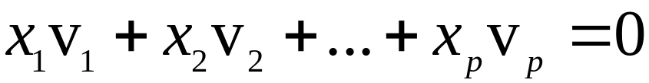
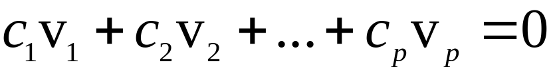
LINEAR INDEPENDENCE
Definition: An indexed set of vectors {v₁, …, v_{p}} in
is said to be linearly independent if the vector equation
has only the trivial solution. The set {v₁, …, v_{p}} is said to be linearly dependent if there exist weights c₁, …, c_{p}, not all zero, such that
----(1)

Slide 3
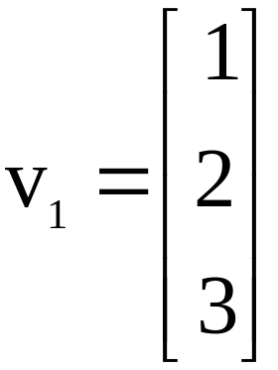
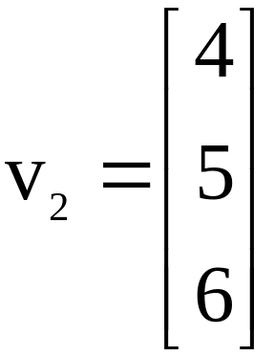
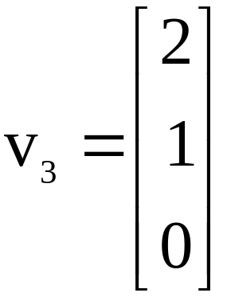
LINEAR INDEPENDENCE
Equation (1) is called a linear dependence relation among v₁, …, v_{p} when the weights are not all zero.
An indexed set is linearly dependent if and only if it is not linearly independent.
Example 1: Let , , and .

Slide 4
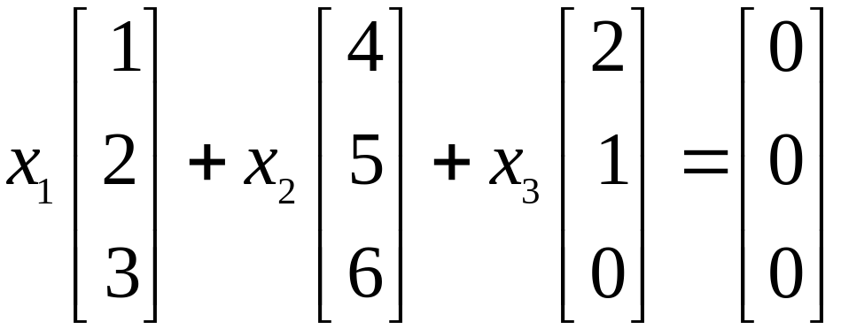
    Determine if the set {v₁, v₂, v₃} is linearly independent.
    If possible, find a linear dependence relation among v₁, v₂, and v₃.
Solution: We must determine if there is a nontrivial solution of the following equation.

Slide 5
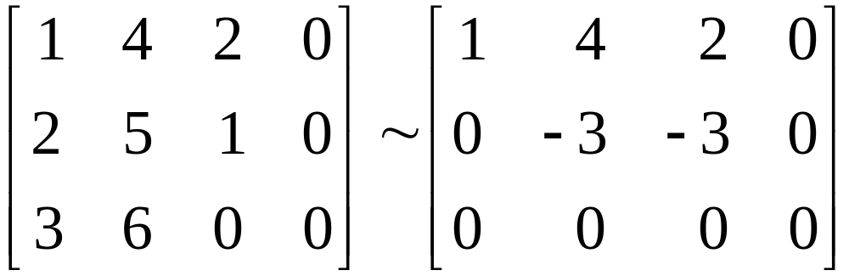
LINEAR INDEPENDENCE
Row operations on the associated augmented matrix show that
.
x₁ and x₂ are basic variables, and x₃ is free.
Each nonzero value of x₃ determines a nontrivial solution of (1).
Hence, v₁, v₂, v₃ are linearly dependent.

Slide 6
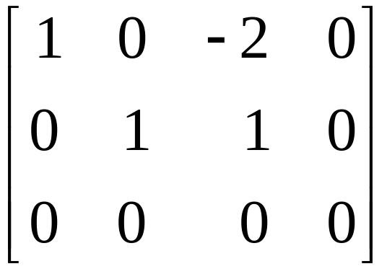
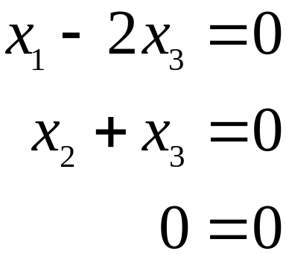





LINEAR INDEPENDENCE
    To find a linear dependence relation among v₁, v₂, and v₃, row reduce the augmented matrix and write the new system:
Thus, , , and x₃ is free.
Choose any nonzero value for x₃—say, .
Then and .

Slide 7
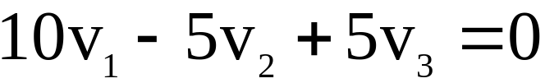
LINEAR INDEPENDENCE
Substitute these values into equation (1) and obtain the equation below.
This is one (out of infinitely many) possible linear dependence relations among v₁, v₂, and v₃.

Slide 8
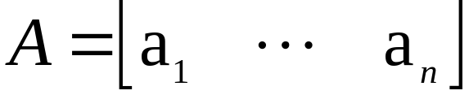

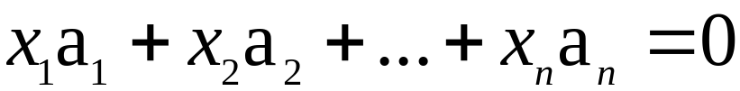
LINEAR INDEPENDENCE OF MATRIX COLUMNS
Suppose that we begin with a matrix
instead of a set of vectors.
The matrix equation can be written as
.
Each linear dependence relation among the columns of A corresponds to a nontrivial solution of .
Thus, the columns of matrix A are linearly independent if and only if the equation has only the trivial solution.

Slide 9
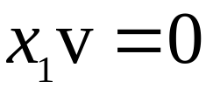

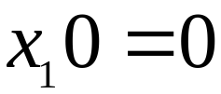
SETS OF ONE OR TWO VECTORS
A set containing only one vector – say, v – is linearly independent if and only if v is not the zero vector.
This is because the vector equation has only the trivial solution when .
The zero vector is linearly dependent because has many nontrivial solutions.

Slide 10
SETS OF ONE OR TWO VECTORS
A set of two vectors {v₁, v₂} is linearly dependent if at least one of the vectors is a multiple of the other.
The set is linearly independent if and only if neither of the vectors is a multiple of the other.

Slide 11
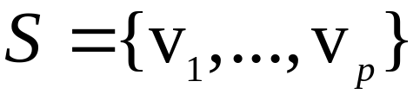
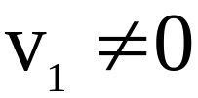

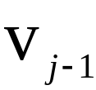
SETS OF TWO OR MORE VECTORS
Theorem 7: Characterization of Linearly Dependent Sets
An indexed set of two or more vectors is linearly dependent if and only if at least one of the vectors in S is a linear combination of the others.
In fact, if S is linearly dependent and , then some v_{j} (with ) is a linear combination of the preceding vectors, v₁, …, .

Slide 12

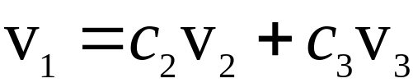
SETS OF TWO OR MORE VECTORS
Proof: If some v_{j} in S equals a linear combination of the other vectors, then v_{j} can be subtracted from both sides of the equation, producing a linear dependence relation with a nonzero weight on v_{j}.
[For instance, if , then
.]
Thus S is linearly dependent.
Conversely, suppose S is linearly dependent.
If v₁ is zero, then it is a (trivial) linear combination of the other vectors in S.

Slide 13
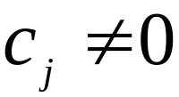

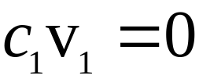
SETS OF TWO OR MORE VECTORS
Otherwise, , and there exist weights c₁, …, c_{p}, not all zero, such that
.
Let j be the largest subscript for which .
If , then , which is impossible because
.

Slide 14
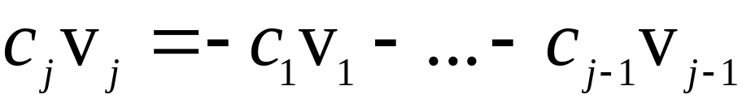
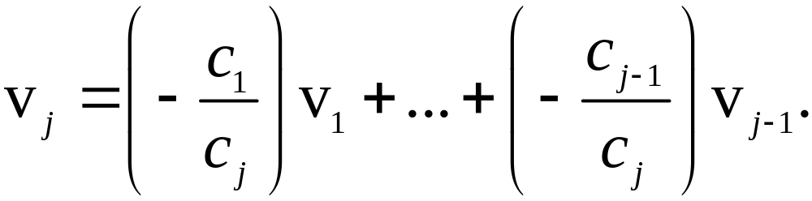
SETS OF TWO OR MORE VECTORS
So , and

Slide 15
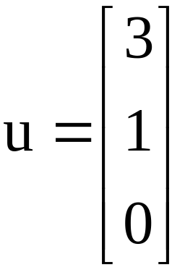
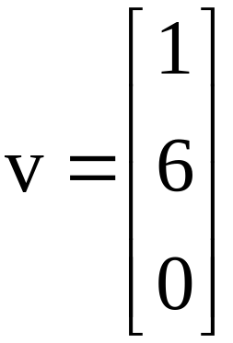
SETS OF TWO OR MORE VECTORS
Theorem 7 does not say that every vector in a linearly dependent set is a linear combination of the preceding vectors.
A vector in a linearly dependent set may fail to be a linear combination of the other vectors.
Example 2: Let and . Describe the
set spanned by u and v, and explain why a vector w is in Span {u, v} if and only if {u, v, w} is linearly dependent.

Slide 16



SETS OF TWO OR MORE VECTORS
Solution: The vectors u and v are linearly independent because neither vector is a multiple of the other, and so they span a plane in .
Span {u, v} is the x₁x₂-plane (with ).
If w is a linear combination of u and v, then {u, v, w} is linearly dependent, by Theorem 7.
Conversely, suppose that {u, v, w} is linearly dependent.
By theorem 7, some vector in {u, v, w} is a linear combination of the preceding vectors (since ).
That vector must be w, since v is not a multiple of u.

Slide 17
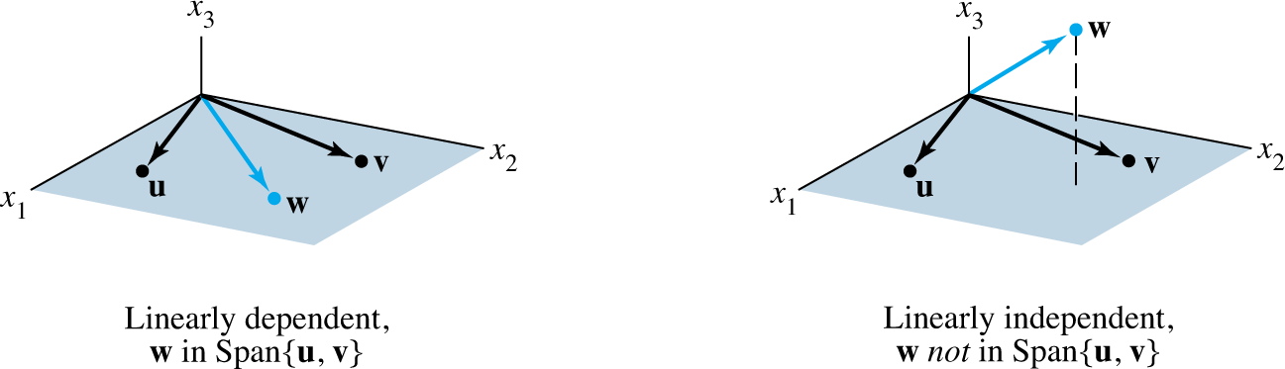
SETS OF TWO OR MORE VECTORS
So w is in Span {u, v}. See the figures given below.
Example 2 generalizes to any set {u, v, w} in with u and v linearly independent.
The set {u, v, w} will be linearly dependent if and only if w is in the plane spanned by u and v.

Slide 18

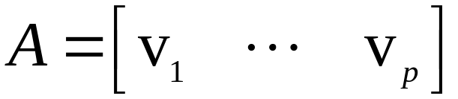

SETS OF TWO OR MORE VECTORS
Theorem 8: If a set contains more vectors than there are entries in each vector, then the set is linearly dependent. That is, any set {v₁, …, v_{p}} in is linearly dependent if .
Proof: Let .
Then A is , and the equation corresponds to a system of n equations in p unknowns.
If , there are more variables than equations, so there must be a free variable.

Slide 19
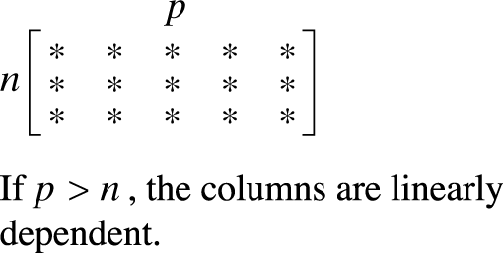
SETS OF TWO OR MORE VECTORS
Hence has a nontrivial solution, and the columns of A are linearly dependent.
See the figure below for a matrix version of this theorem.
Theorem 8 says nothing about the case in which the number of vectors in the set does not exceed the number of entries in each vector.

Slide 20
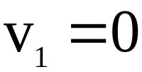
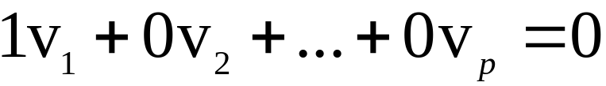
SETS OF TWO OR MORE VECTORS
Theorem 9: If a set in contains the zero vector, then the set is linearly dependent.
Proof: By renumbering the vectors, we may suppose
.
Then the equation shows that S in linearly dependent.

